Slide 1




Desktop Applications
Windows Applications and Services
SoftUni Team
Technical Trainers
Software University
http://softuni.bg

Slide 2

Table of Contents
Designing Windows Forms
Windows Forms Event Model
Visual Interface
Multiple Document Interface (MDI) Applications
Console-based Applications
Windows Services
Creation, installation etc.
Working with Windows Services

Slide 3
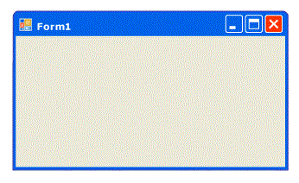
Windows Forms

Slide 4
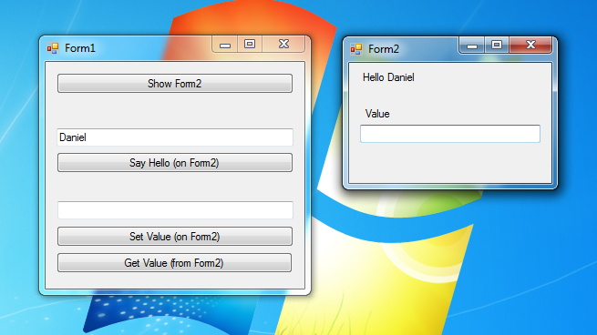
Windows Forms Applications
Windows Forms applications are smart client applications consisting of one or more forms that display a visual interface to the user
These applications integrate well with the operating system
use connected devices
can work whether connected to the Internet or not

Slide 5
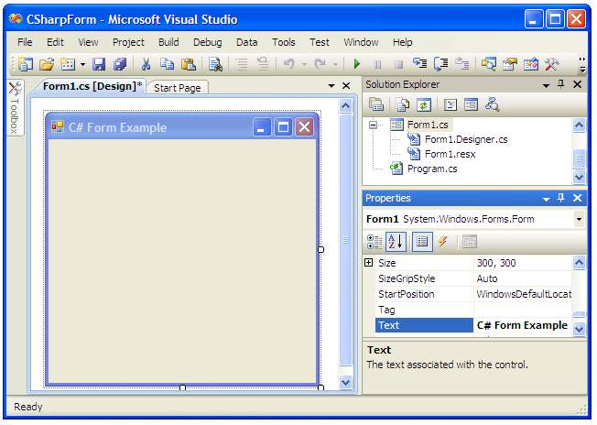
Windows Forms
A Windows Form is a visual surface which, the developers, enhance with controls to create a user interface and with code to manipulate data
Visual Studio provides a drag-and-drop Windows Forms designer that you can use to easily create your applications

Slide 6
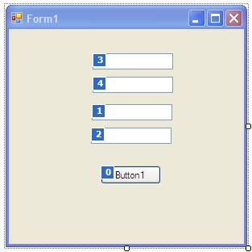

Live Demo

Slide 7
Windows Forms Event Model
Event handling plays a key role in user interface-based programming. Through event handling, you:
Respond to various events that are fired as a result of user actions
Make programs interactive
Each form and control exposes a predefined set of events
When an event occurs, the code in the associated event handler is invoked
this.age.ValueChanged =
new System.EventHandler(this.age_ValueChanged);

Slide 8
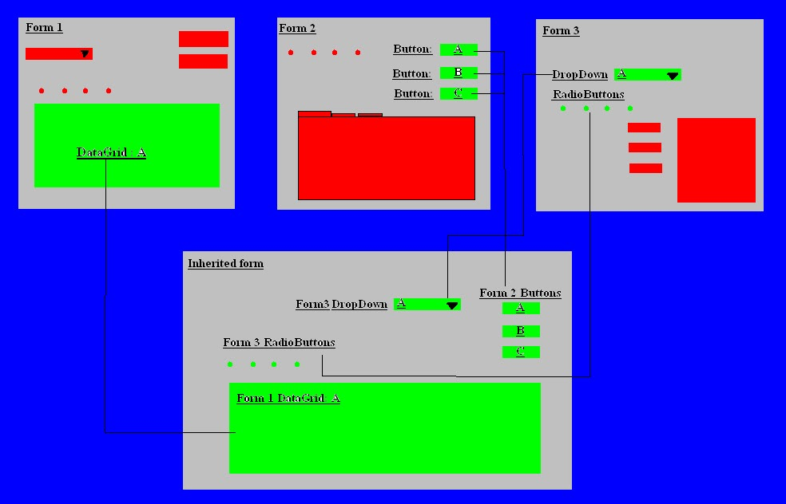
Visual Inheritance
Visual inheritance enables you to see the controls on the base form and to add new controls
Form is a class, therefore Inheritance is just another OOP Principle for it
Inheritance applied to a Windows Form, causes the inheritance of all the visual characteristics of a form

Slide 9
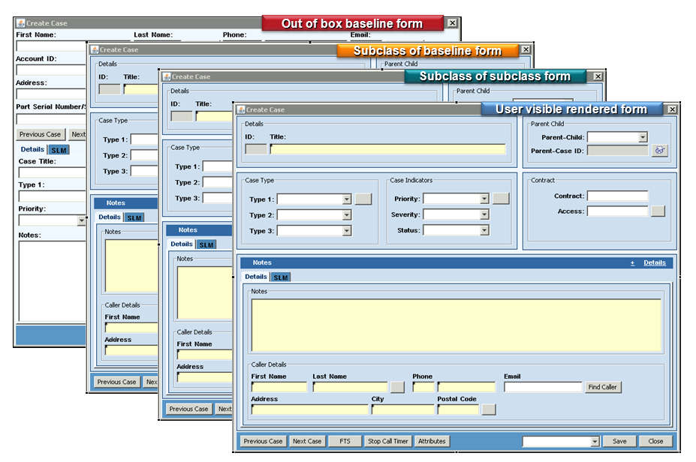
Live Demo

Slide 10
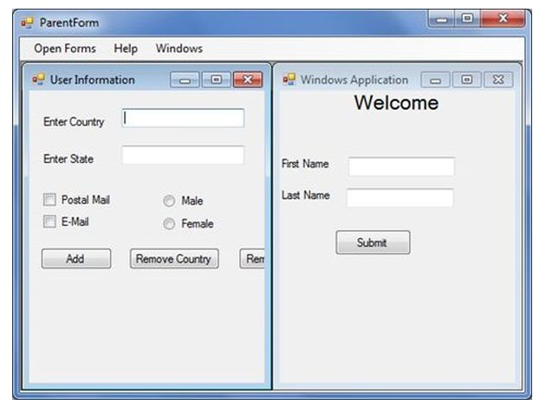
Multiple Document Interface Applications
Multiple Document Interface (MDI) applications are applications in which multiple child windows reside under a single parent window.
Allows the user to display multiple documents at the same time
MDI applications often support management of multiple child windows trough a specified control

Slide 11
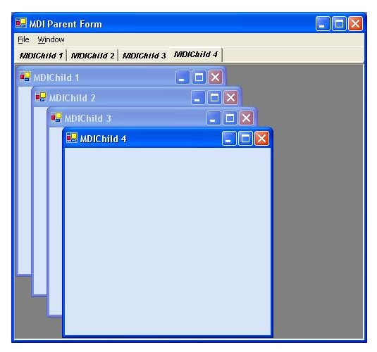
Live Demo

Slide 12
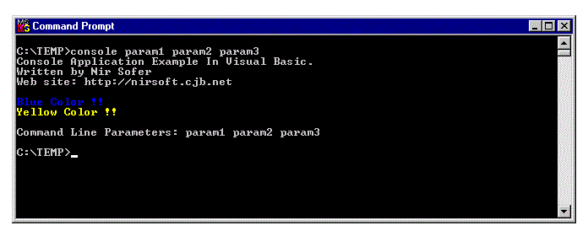
Console-Based Applications

Slide 13
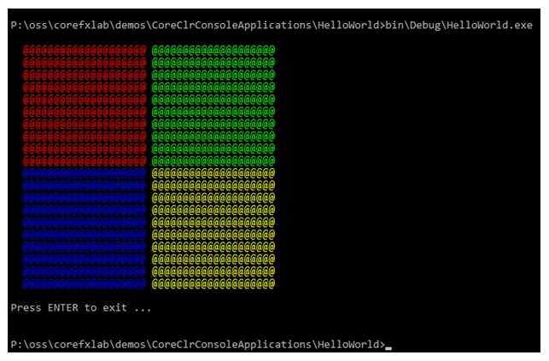
Console Applications
Console-based applications do not have a graphical user interface
use a text-mode console window to interact with the user
The input can be provided using command-line parameters
the output of a console application is written to the command window

Slide 14
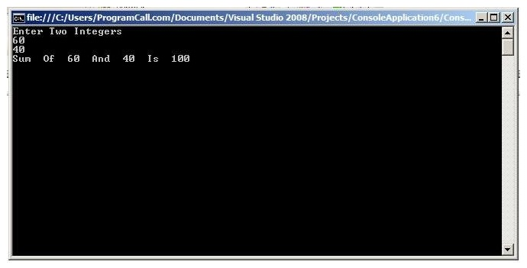
Working with Console Applications

Slide 15

Windows Services

Slide 16

Windows Service
A Windows Service is a computer program that operates in the background
must conform to the interface rules and protocols of the Service Control Manager - the component responsible for managing Windows services
Can be configured to start when the operating system is started
Can operate even when a user is not logged on

Slide 17
Windows Service
To create a Windows service in Visual Studio the use of the Windows Service application template is necessary
Note that a Windows service must be installed before it can be used
All Windows services must derive from the ServiceBase class
The ServiceBase class provides the basic structure and functionality for creating a Windows service

Slide 18
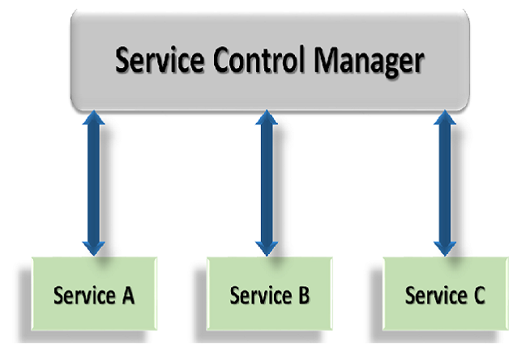
Work with Windows Services

Slide 19

Summary
What are Windows Forms?
How to create and use Windows Forms
Windows Form Event Model
Visual Inheritance
Console-Based Applications
How to create and use Console Apps
Windows Services
Creation and use of Windows Services
Installing Windows Services

